Slide 1

Chapter 15
Connecting LANs,
Backbone Networks,
and Virtual LANs
15.<number>
Copyright © The McGraw-Hill Companies, Inc. Permission required for reproduction or display.

Slide 2
15-1 CONNECTING DEVICES
In this section, we divide connecting devices into five different categories based on the layer in which they operate in a network.
Topics discussed in this section:
Passive Hubs
Active Hubs
Bridges
Two-Layer Switches
Routers
Three-Layer Switches
Gateways
15.<number>

Slide 3

Figure 15.1 Five categories of connecting devices
15.<number>

Slide 4

Figure 15.2 A repeater connecting two segments of a LAN
15.<number>

Slide 5

Note
A repeater connects segments of a LAN.
A repeater forwards every frame;
it has no filtering capability.
A repeater is a regenerator,
not an amplifier.
bit for bit copy
remove noise, but do not correct/detect error
Recover the signal strength
15.<number>

Slide 6

Figure 15.3 Function of a repeater
15.<number>

Slide 7

Figure 15.4 A hierarchy of hubs
A hub is actually a multiport repeater
15.<number>

Slide 8
Note
A bridge checks MAC addresses. It has a table used in filtering decisions (Forward? Drop?). The table shows the map between MAC addresses and ports.
In Ethernet, Ethernet switch
is a bridge device
15.<number>

Slide 9

Figure 15.5 A bridge connecting two LANs
15.<number>

Slide 10
Note
A bridge does not change the physical (MAC) addresses in a frame.
15.<number>

Slide 11

Figure 15.6 A learning bridge and the process of learning
15.<number>

Slide 12

Figure 15.11 Routers (layer-three switch)
connecting independent LANs and WANs
15.<number>

Slide 13
15-3 VIRTUAL LANs
We can roughly define a virtual local area network (VLAN) as a local area network configured by software, not by physical wiring.
Topics discussed in this section:
Membership
Configuration
Communication between Switches
IEEE Standard
Advantages
15.<number>

Slide 14
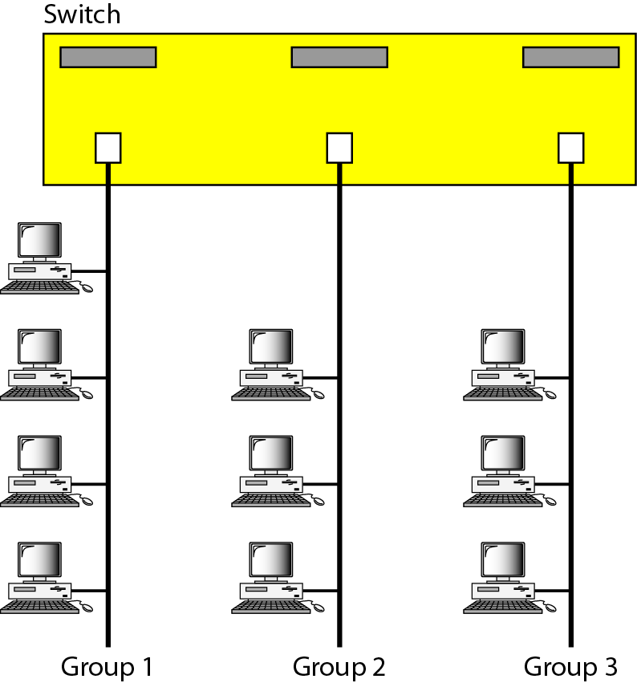
Figure 15.15 A switch connecting three LANs
Physical wiring makes it hard to
dynamically change group allocation
15.<number>

Slide 15

Figure 15.16 A switch using VLAN software
15.<number>

Slide 16

Figure 15.17 Two switches in a backbone using VLAN software
15.<number>
Good for a company with two separate buildings

Slide 17
Note
VLANs create broadcast domains.
15.<number>

Slide 18
VLAN: Membership Definition
Switch port Numbers
MAC Address
IP Address
Multicast IP Address
Combination
15.<number>

Slide 19
VLAN Configuration
Manually
Automatic
Semiautomatic
15.<number>

Slide 20
VLAN: Communication between switches
Table maintenance
Frame tagging
  Extra header added to MAC frame to define the destination VLAN
Time-Division Multiplexing (TDM)
15.<number>

Slide 21
VLAN: Advantages
Cost and time reduction
Creating Virtual Work Groups
Security
  Separation of broadcast messages
15.<number>

